Slide 1
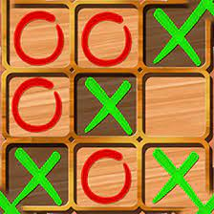
TIC-TAC-TOE

Slide 2
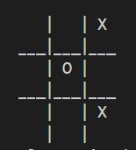
INTRODUCTION
Tic-tac-toe is a classic game, but it is surprisingly challenging to win. Even if you have a good strategy, there is always the chance that your opponent will make a lucky move and win. This makes tic-tac-toe a fun and exciting game for people of all ages.

Slide 3
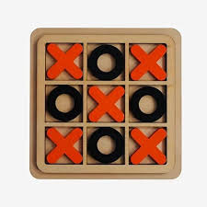
OVERVIEW
The game is played on a 3x3 grid.
Each player takes turns placing their mark (usually X or O) in an empty square.
The first player to get three of their marks in a row (horizontally, vertically, or diagonally) wins the game.
If all nine squares are filled and neither player has three in a row, the game is a draw.

Slide 4
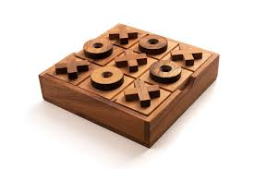
FUNCTIONS USED
DrawBoard(): This function draws the game board on the console.
CheckPosition(): This function checks if the specified position on the board is empty.
CheckWin(): This function checks if the game is over and there is a winner.

Slide 5
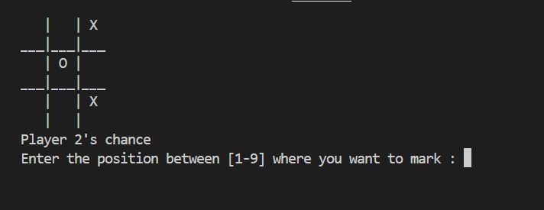
GAME EXPLANATION
Run the Python script.
The game will start with a blank board.
Players take turns placing their
symbols on the board.
Compete with each other
to win the game.

Slide 6
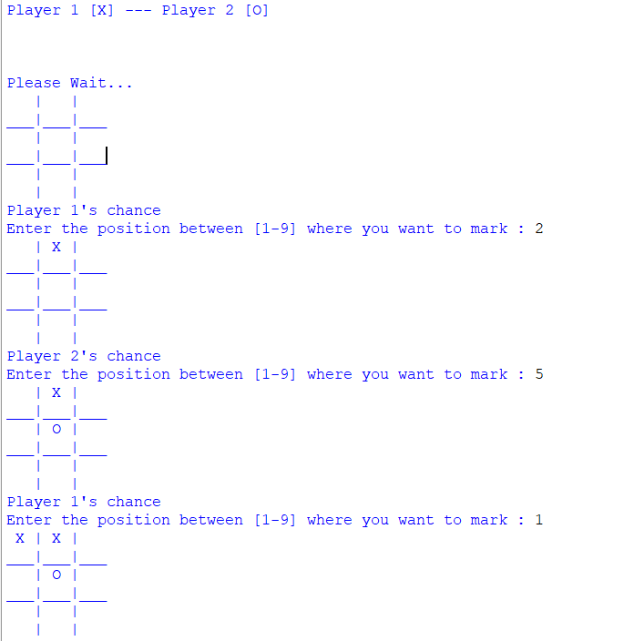
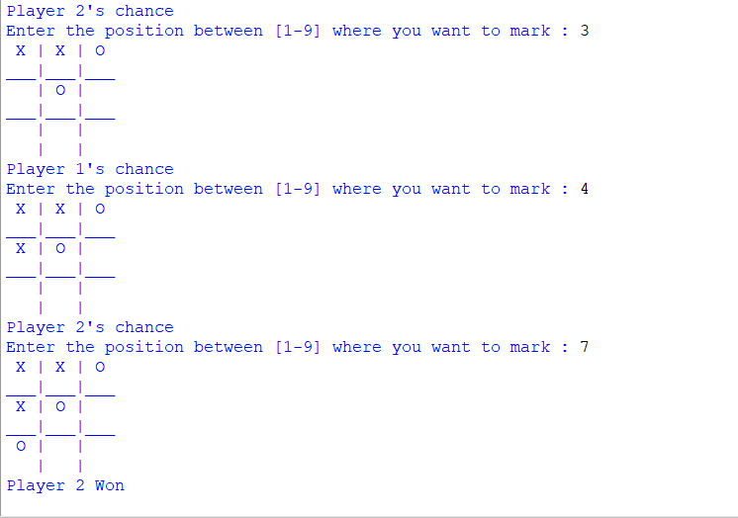
OUTPUT

Slide 7
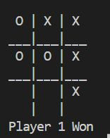
CONCLUSION
In this presentation, we have learned
how to code a Tic Tac Toe game
in Python. We have seen how to
define the game board, the players, and the rules of the
game. We have also seen how to write code to draw the
game board, get the player's move, and check for a winner.

Slide 8



